Slide 1
Welcome!
SS2857 Probability and Statistics I Fall 2024

Slide 2
Course Information
Brightspace
Content
Course Administration
STAT2857_course_outline
Course Schedule
Finding Your Way

Slide 3
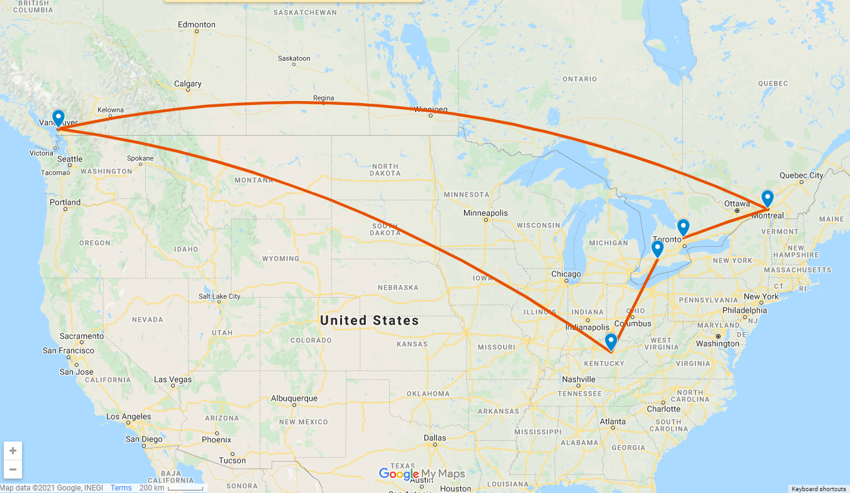
A little about me…

Slide 4
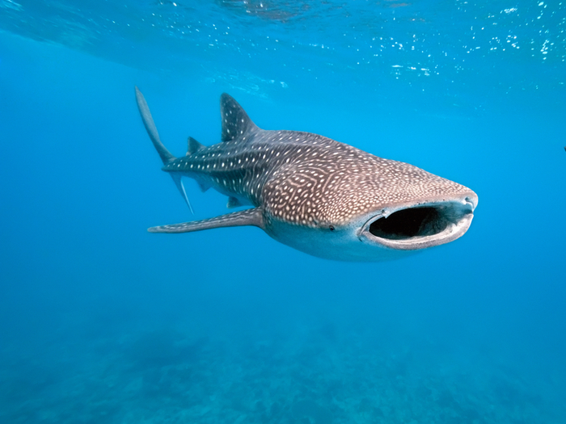
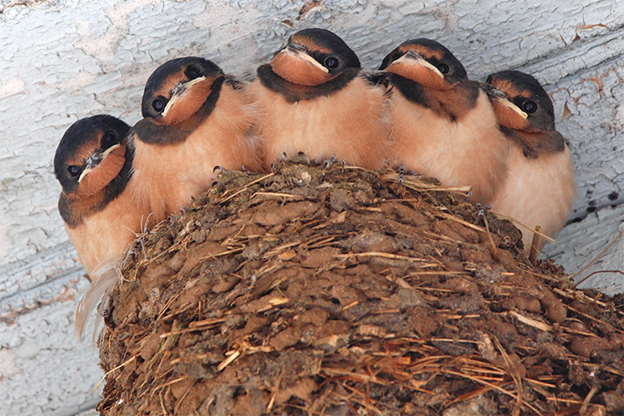

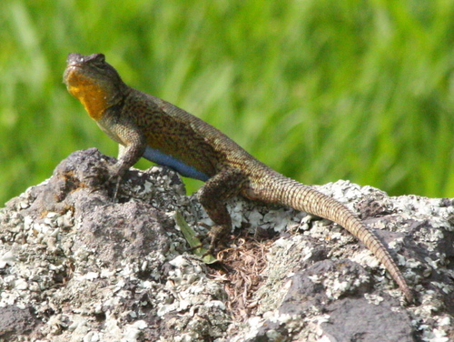
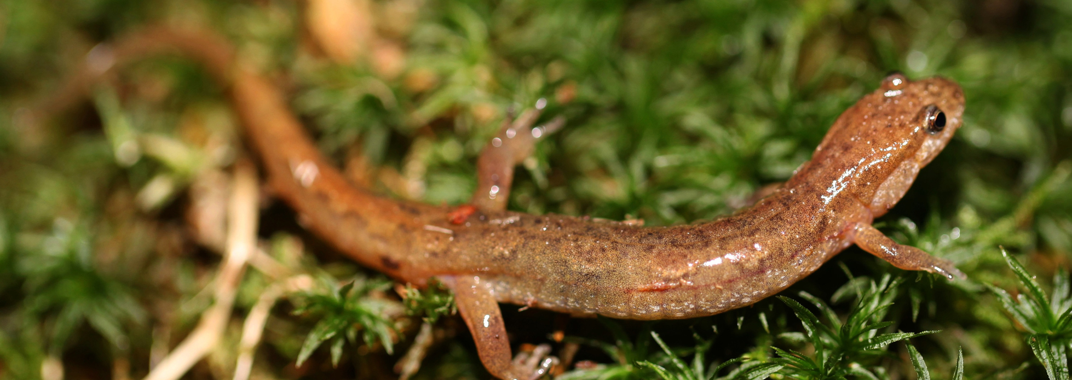
A little about me…

Slide 5
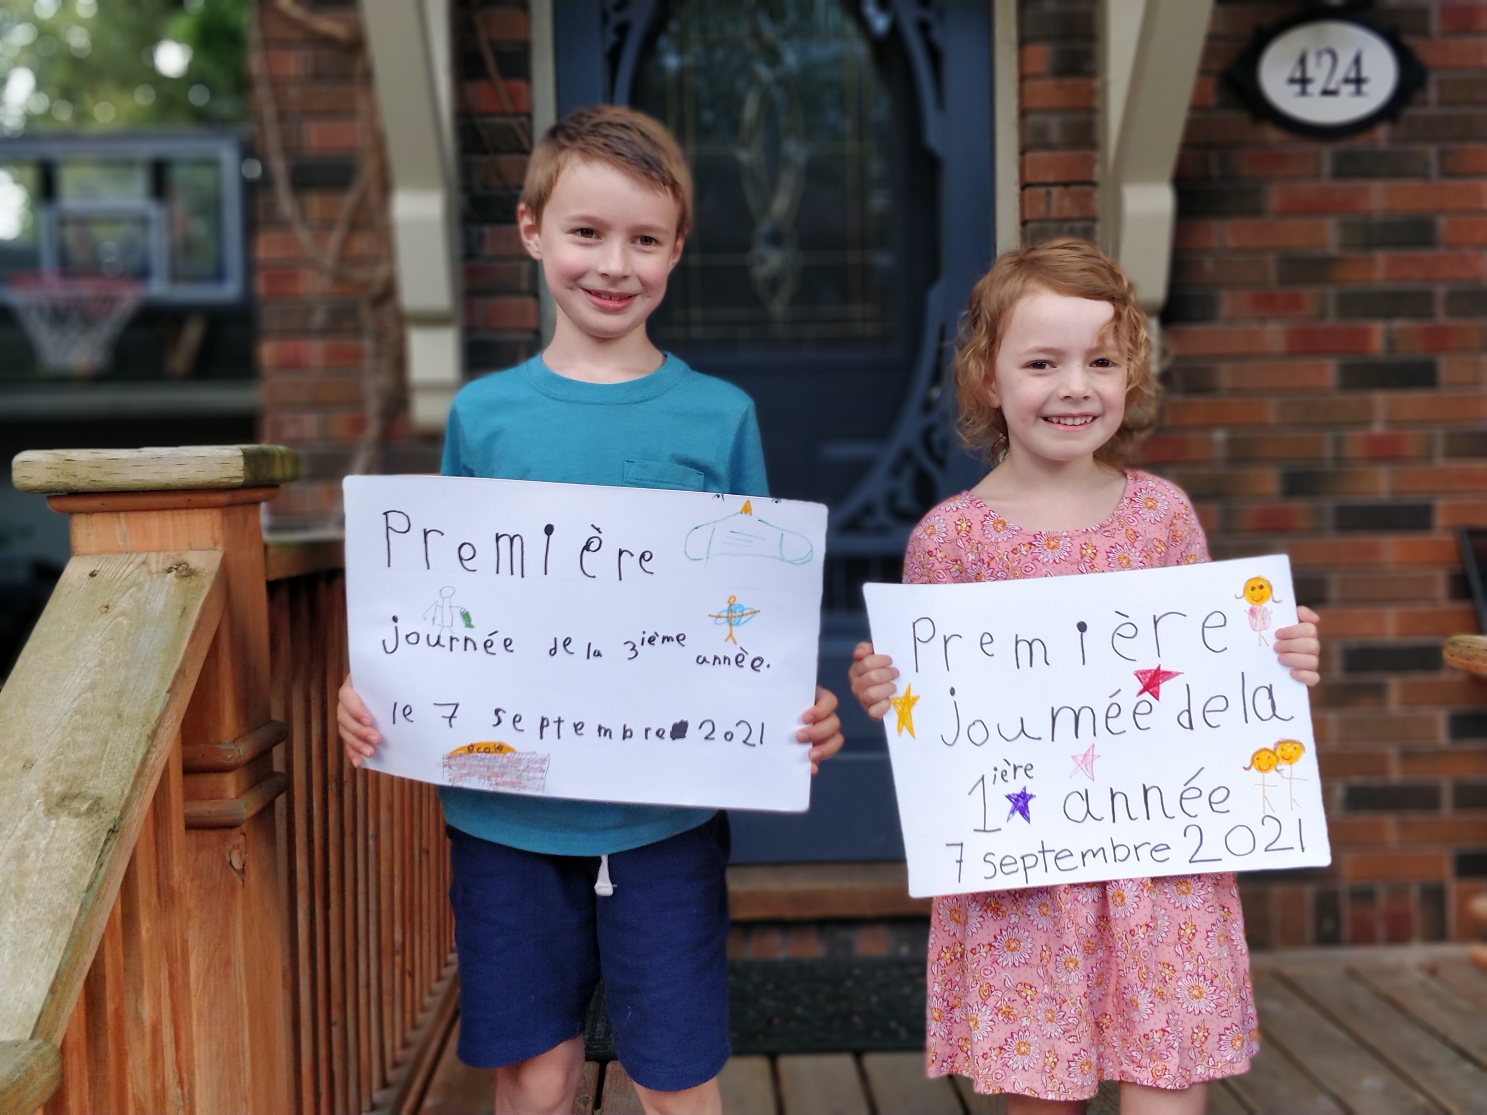
A little about me…

Slide 6
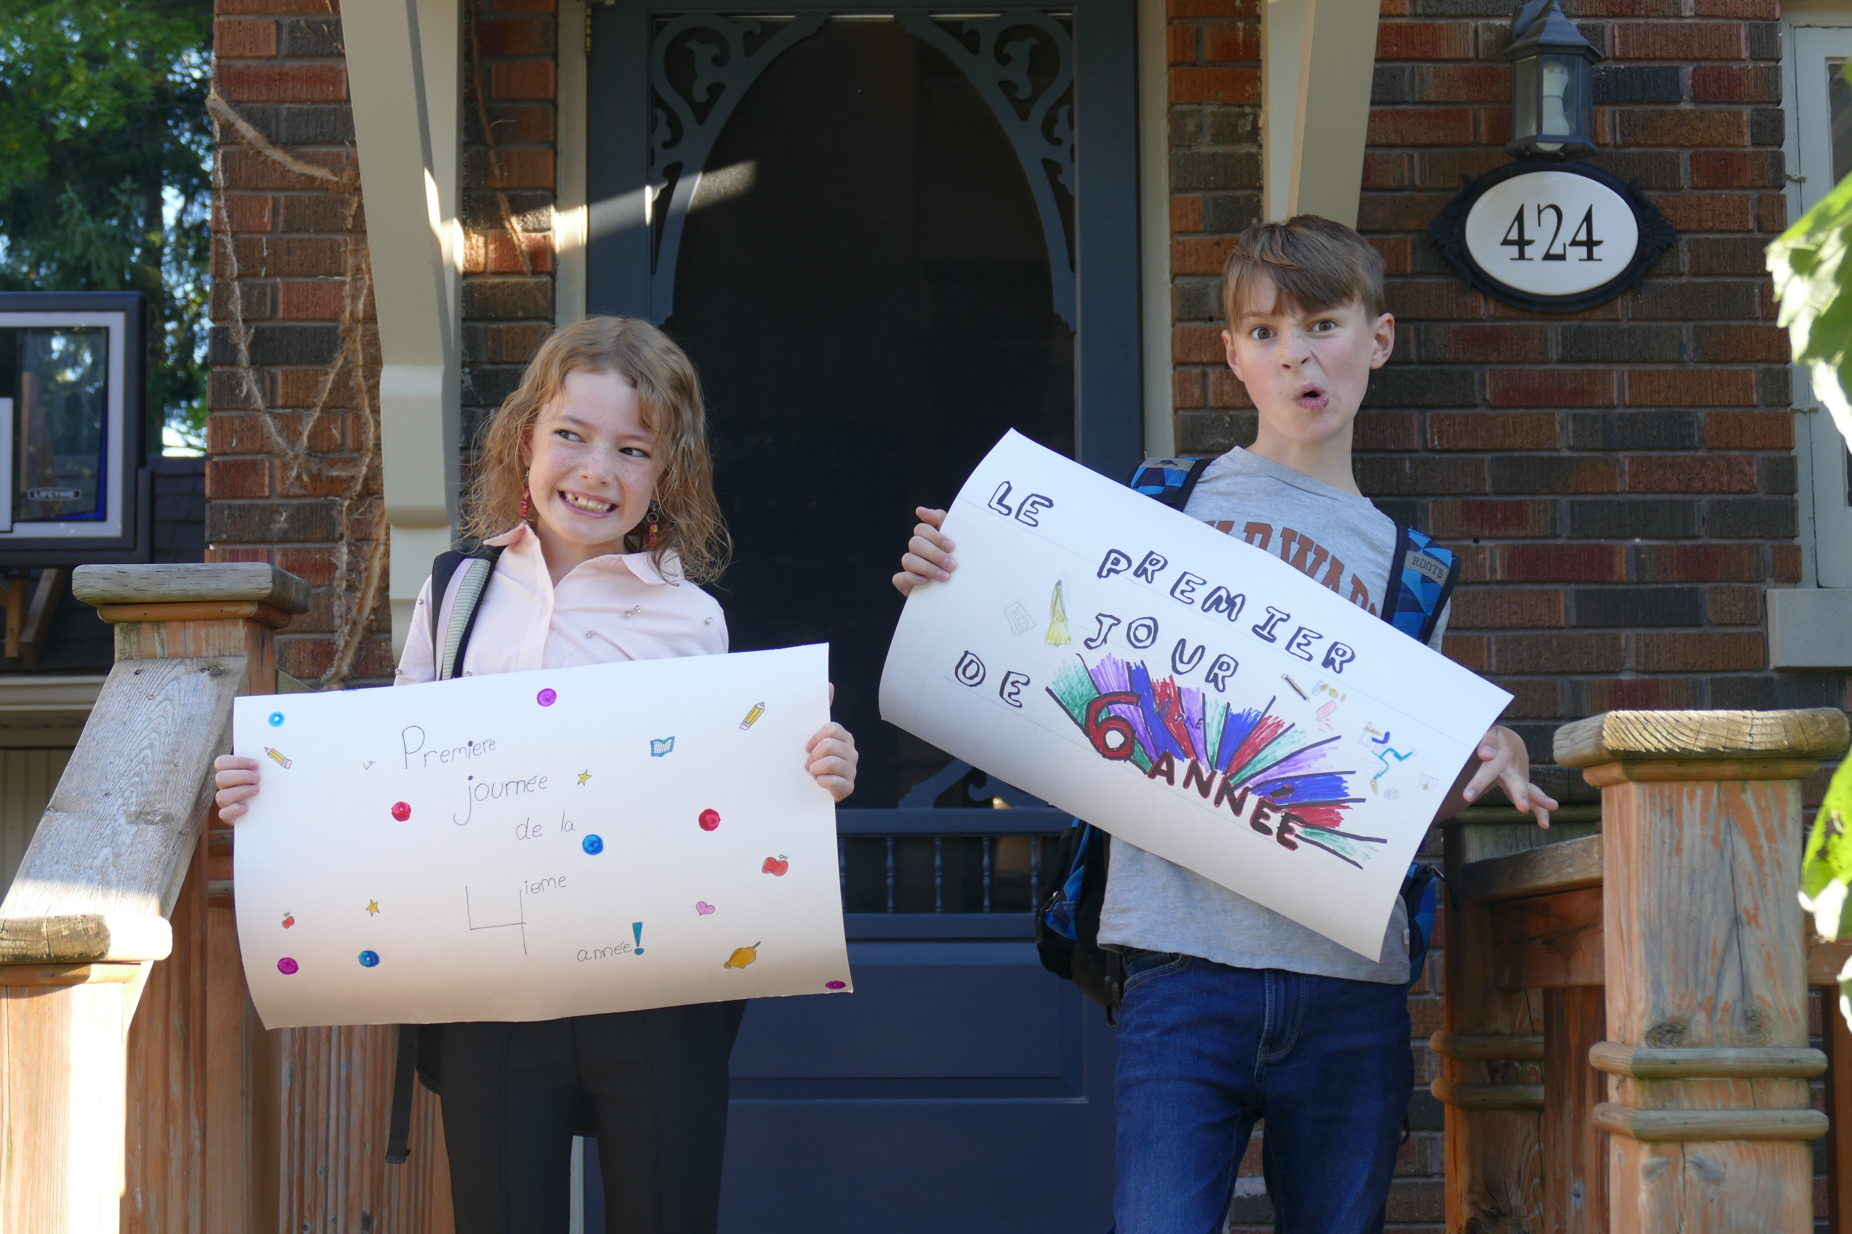
A little about me…

Slide 7



A little about me…

Slide 8


A little about me…

Slide 9
How to do well in this course
Read the sections in the textbook.
Ask questions!
Attend the lectures.
Ask questions!
Review the examples and exercises.
Ask questions!
Complete practice exercises.
Ask questions!
Write the quizzes and review the solutions.
Ask questions!
Write the midterm and review the solutions.
Ask questions!
Write the final exam.

Slide 10
Activity #1
Let’s play a game!
My bag contains 24 marbles – some white and some black.
You will:
1. Choose one colour (black or white).
2. Pick a marbles from the bag.
You win if you correctly predict the colour. Otherwise, I win.

Slide 11
Probability and Statistics
Probability (STAT 2857)
Population
Sample
Inferential Statistics (STAT 2858)

